Slide 1



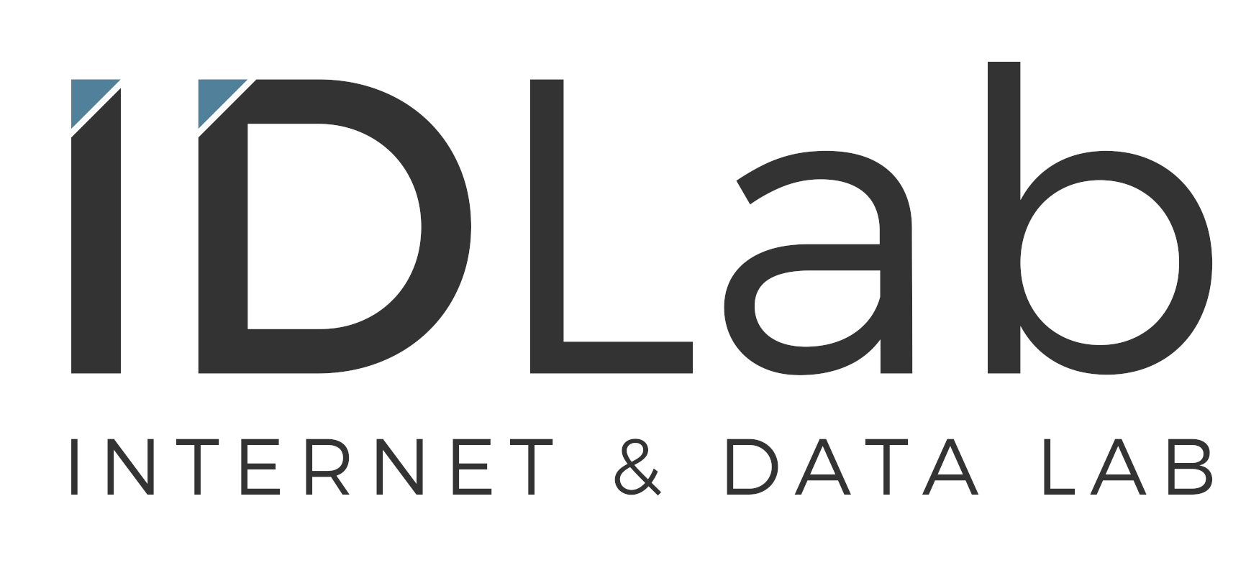
PErsoNal Genome QUery IN healthcare and clinical practice
Elias Crum

Slide 2
PENGQUIN
PErsoNal Genome QUery IN healthcare and clinical practice

Slide 3

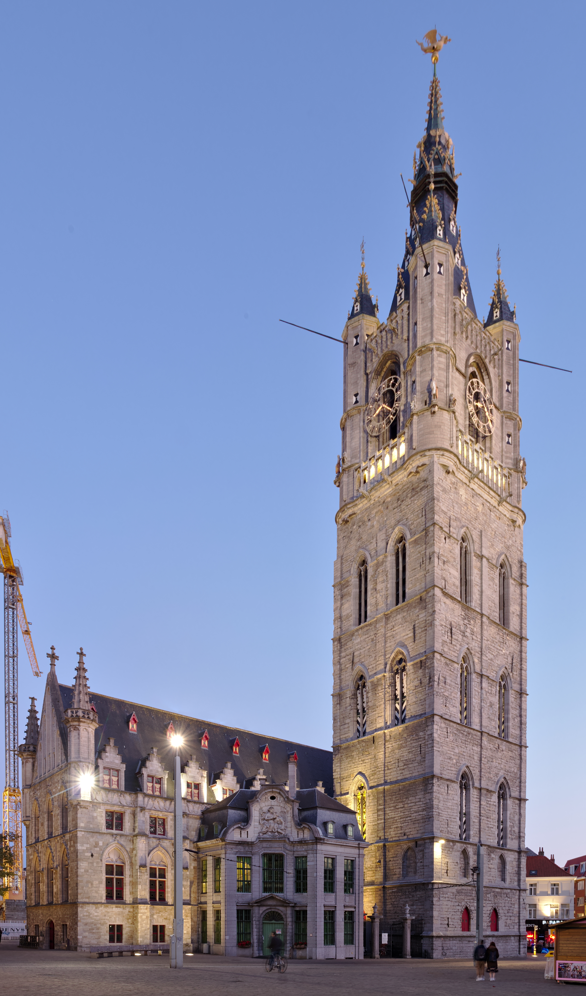

Human Genome
Ghent Belfry
Genome data is big...
~130m
~3.2 BILLION base pairs ----> ~1 GB
~91m
~3.2 BILLION base pairs ----> ~1 GB
Printed
Human Genome¹
Bergström et al. SCIENCE 20 Mar 2020.

Slide 4
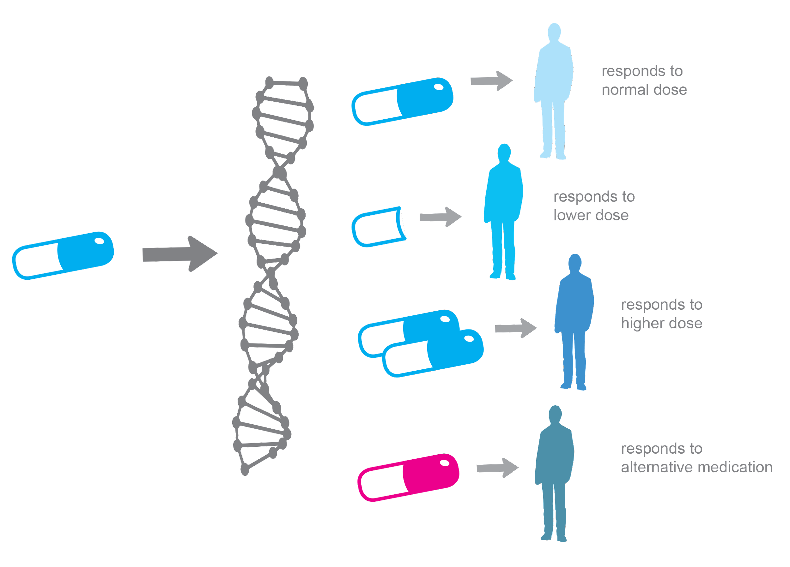
Personalized Medicine
All human diseases are influenced by genetics
Personalized Medicine = Medical care informed by an individual’s genetic profile
Examples:
Drug prescription
Cancer diagnosis
Cancer therapy development and targeting
Genetic disease screening
Jackson et al. Essays Biochem.3 Dec 2018.
https://alphagenomix.com/empowering-personalized-medicine/

Slide 5


Research Context
Challenges to personalized medicine?
Genome storage and querying
Why?
~3 BILLION base pairs
Privacy concerns
Genome storage
Stored data querying

Slide 6
Sequencing Storage
The human genome = ~3 billion base pairs
3 billion letters == ~700 megabytes
Format: TXT file
Raw human whole genome sequence == ~200 gigabytes
Format: FASTQ file
Aligned human whole genome sequence == ~100 gigabytes // ~15 gigabytes
Format: BAM file // CRAM file
Human genome variant file (list of mutations) == ~125 megabytes
Format: VCF file

Slide 7
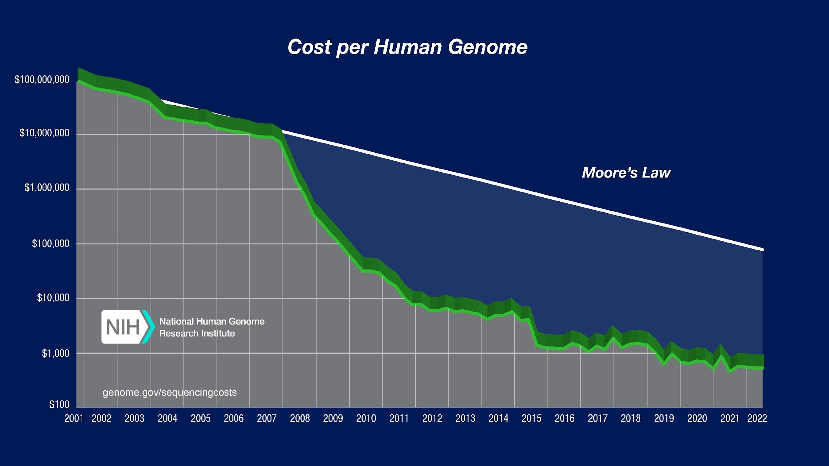
Sequencing and Storage Costs
Currently ~€300 per genome
https://www.genome.gov/about-genomics/fact-sheets/Sequencing-Human-Genome-cost
Per-base cost of sequencing has been dropping by half every ~5 months
Per-base cost of sequence data storage is dropping by half every ~14 months

Slide 8
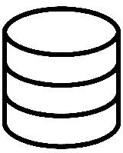

Sequencing and Storage Costs
By 2025, it is projected that human genome sequence storage will surpass cumulative data stored from social media platforms
<
Stevens et al. 2015. https://doi.org/10.1371/journal.pbio.1002195

Slide 9


Research Questions
Can a personal genome sequence storage framework be developed that provides :
Efficient storage structure
Personal control over storage privacy and sharing
Performant querying capabilities
Can querying algorithms be developed that are both efficient and scalable ?
Can this framework be built on a standardized data accessing system?

Slide 10
Objectives
(1) Investigate the current landscape of genome data storage and the Solid ecosystem
Deliverable → Review Paper Composition
(2) Produce a personal genome sequence test dataset for experimentation
Deliverable → Test dataset
(3) Investigate the storage of personal genome data in Solid data pods
Deliverable → Genome data ontology + Solid pod data ingestion protocol
(4) Develop querying algorithms for the retrieval of genomic data from personal Solid pods
Deliverable → Querying algorithm(s) for genome data searchability
(5) Ensure practical applicability of project to real-world situations
Deliverable → OMOP genomic-CDM compatible data formatting

Slide 11
Approach
Genome File
Define Genome File Ontology
*OMOP g-CDM compatible
Data Ingestion
Solid Pod

Slide 12
Approach
Storage and querying steps will require optimization
Genome File
Define Genome File Ontology
Query Algorithm
Query Input
Query Engine
Solid Pod
Output

Slide 13

Thoughts about a solution
Large knowledge graph traversal is not a trivial querying problem
Current ideas for achieving “good” performance:
Genomic linked data structure leveraging
Gene locus / quality filtering / etc.
Search caching in query engine
Pre-computed summaries / indexes for more efficient data “location” determination

Slide 14


How this fits at VITO
VITO Health Parallel Projects:
Beyond the Genome: Ethical Aspects of Large Cohort Studies
I am frontier study
Pharmacogenomics Passports being developed as part of a collaborative project with JESSA and UHasselt
VITO Solid for personal data management projects:
“We Are” project
Setting up a personal data platform (technology + governance)
PhD UHasselt (Dore Staquet): information retrieval from large multi-pod solid systems
AI Flanders, use case on solid: agent-based model to handle queries on data in pods
Expand genome storage framework to other health institutions beyond VITO and its partners

Slide 15
Applications
Algorithms, methodologies, and results to be implemented in:
Ongoing pharmacogenomics projects within VITO
Institutions partnered with VITO, JESSA and Ghent University such as Domus Medica along with other hospitals
Connection of personal genome pods to the OMOP network
WE ARE initiative in data privacy and protection
Belgian Genome Biobank

Slide 16
Questions?

Slide 17
Sources
Slide 6 (Sequencing Storage):
Cock, P. J. A., Fields, C. J., Goto, N., Heuer, M. L. & Rice, P. M. The Sanger FASTQ file format for sequences with quality scores, and the Solexa/Illumina FASTQ variants. Nucleic Acids Res 38, 1767–1771 (2010).
Li, H. et al. The Sequence Alignment/Map format and SAMtools. Bioinformatics 25, 2078–2079 (2009).
Bonfield, J. K. CRAM 3.1: advances in the CRAM file format. Bioinformatics 38, 1497–1503 (2022).
Danecek, P. et al. The variant call format and VCFtools. Bioinformatics 27, 2156–2158 (2011).

Slide 18
Supplemental Slides

Slide 19
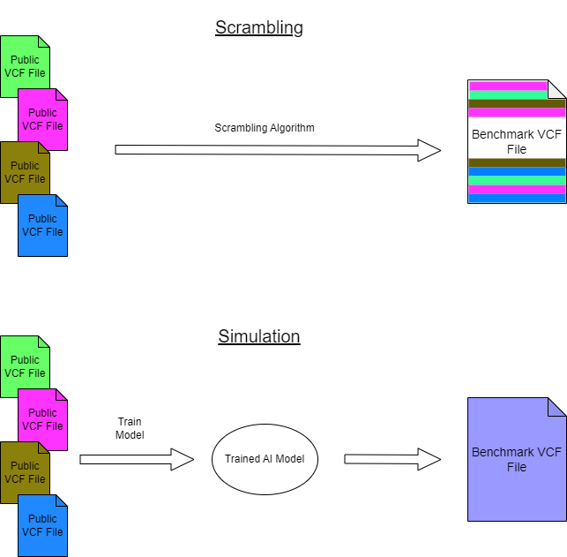
Test data production

Slide 20
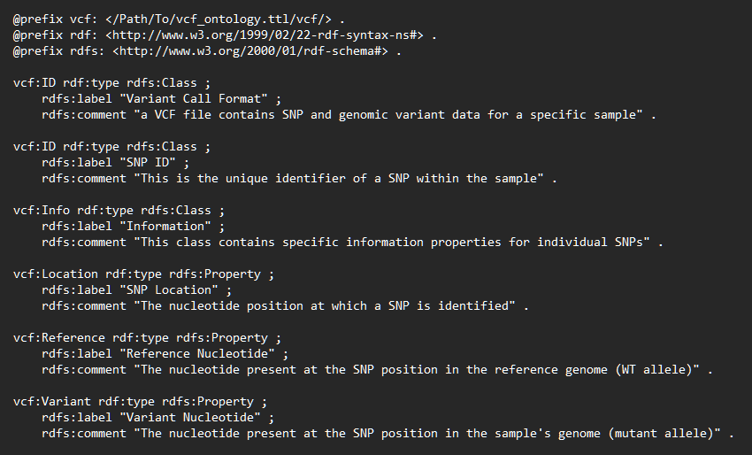
Ontology Definition
Predicate
Subject
Object
Resource Description Format (RDF):
Allele
Gene_A1
“C”
Defining an ontology:

Slide 21
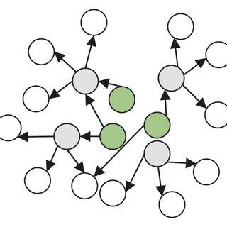
Solid Pod Ingestion
Materialization
Simulation
Full translation of VCF into RDF
Only partial translation of VCF into RDF
Genome Ontology
Query Engine
Genome Ontology
Solid Data Pod
Solid Data Pod
Output

Slide 22
Complementarity of Collaboration
UGent:
Decentralized data querying expertise
Core member of SolidLab
Education oriented
VITO:
Health, biological, and genomic data science expertise
Preliminary experience with genomic data storage within Solid
Real-world application production expertise

Slide 23
Industrial / Societal relevance
Societal:
Consumer in control of their own data
Unintended consequences → disruptive in established data flows
this is researched in We Are (among other things)
Ethical sharing of personal data for research purposes
VITO PhD of Cato Van Schyndel (Health Unit)
Industrial:
Personalized services based on data controlled by users
At VITO, project “SAVE DATA”
proof-of-concept with companies on solid-based commercial applications
Not explored yet for genome data specifically

Slide 24
Sequencing Storage
The human genome = ~3 billion base pairs
3 billion letters == ~700 megabytes
Representative of a single strand of the whole human genome sequence
E.g. : …ATGCCGTAAACAGATGTCA …
Format: TXT file
Raw human whole genome sequence == ~200 gigabytes
Whole genome sequences typically have >=30x coverage at each base position. (i.e. each base of the genome is represented in the sequence file a >= 30 times)
Format: FASTQ file
Aligned human whole genome sequence == ~100 gigabytes // ~15 gigabytes
Whole genome sequence is mapped to a reference human genome and can be stored in various formats. Recent advances have allowed for increased compression.
Format: BAM file // CRAM file
Human genome variant file (list of mutations) == ~125 megabytes
Individual humans only exhibit ~0.1% variation comparatively (~3 million mutations). Variant file records those differences in one individual’s genome compared to the “normal” reference genome.
Format: VCF file

